Slide 1

Natural Language Processing Genealogical extraction from Historical Documents
Michael A. “Lucky” LaChance
Capstone Project
Nashville Software School
May 30, 2020

Slide 2
Agenda
Why this data and technology
The anticipated journey
Actual journey
Process steps
Obstacles (Learning Opportunities)
A view from my current location
The path ahead
Questions

Slide 3
How can I leverage my skills to effectively “map” and “score” relationships from large volumes of text ?
I routinely digest voluminous historical documents to extrapolate seemingly small amount of discrete relationships of particular interest
Human discernment is highly accurate, but exceedingly slow in processing – the opposite has been true of computers but they are getting much better at NLP so they are fast and fairly accurate.
NLP can screening and score relationships from large volumes of free text and graph it, for human review and adjudication

Slide 4

My Envisioned Journey
Identify Genealogical/History Book
Extract and Prep Genealogy sample sentences (May 6th)
Entity Pair Extraction (May 10)
Relation/Predicate Pair (May 17)
Score Relationship strengths (May 24)
Graphing (May 31)
Findings and presentation prep (Jun 2)

Slide 5
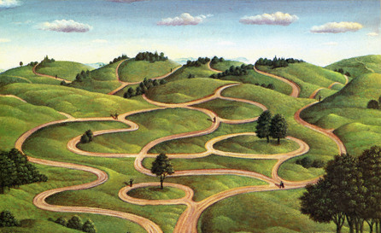

My Actual Journey and View
Identify Genealogical/History Book
Extract and Prep Genealogy sample sentences (May 6th)
Entity Pair Extraction ( )
Relation/Predicate Pair ( )
Score Relationship strengths (May 27)
Graphing (May 28) started researching ETL
Findings and presentation prep (May 28)

Slide 6
The Process
Pre-Process
Process
Report
Extract Text from PDF Documents
Train the Computer
Import to Neo4J
Clean The Data
Validate Model
Analyze
Sentence Dataframe
Improve the model Model
Report
Mark the Relevent Sentences
Extract Relationship
From sentences
Feedback

Slide 7
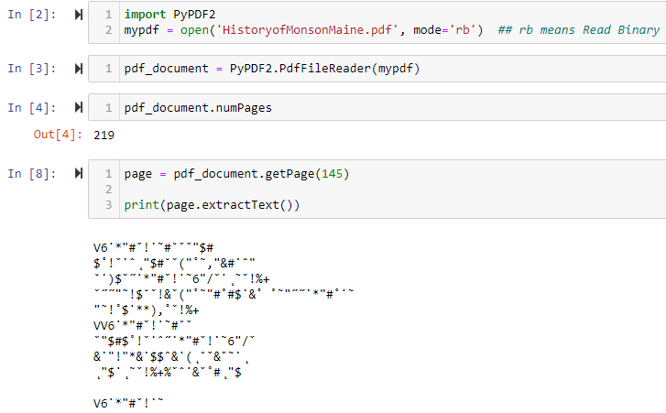
Getting Clean Text to Mark
Thought I could repurpose some previous file looping and add a bit of PDF conversion to convert several files in a folder sequentially
Lesson 1 PDF to Text: Python can convert PDF to Text – But not as easy as I’d hoped. Free online conversion took 3.5 minutes

Slide 8
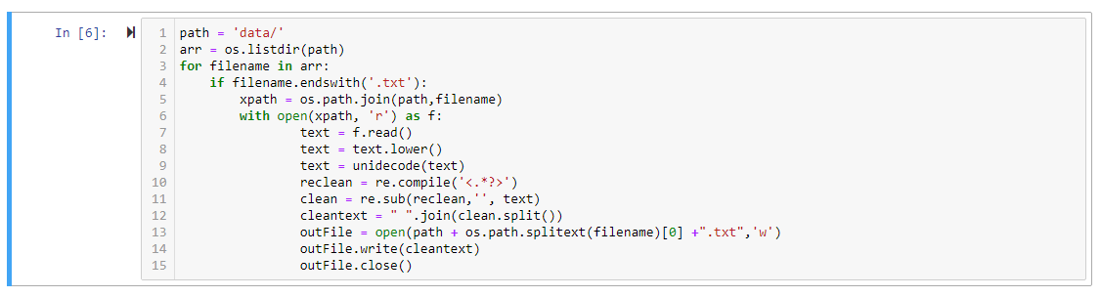
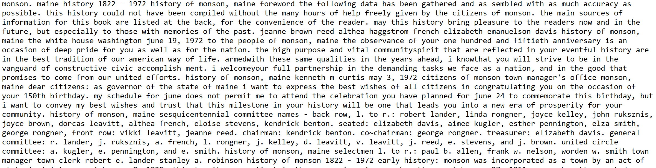
Cleaning - Continued
1st round wasn’t very clean and it wasn’t in a DataFrame for marking

Slide 9
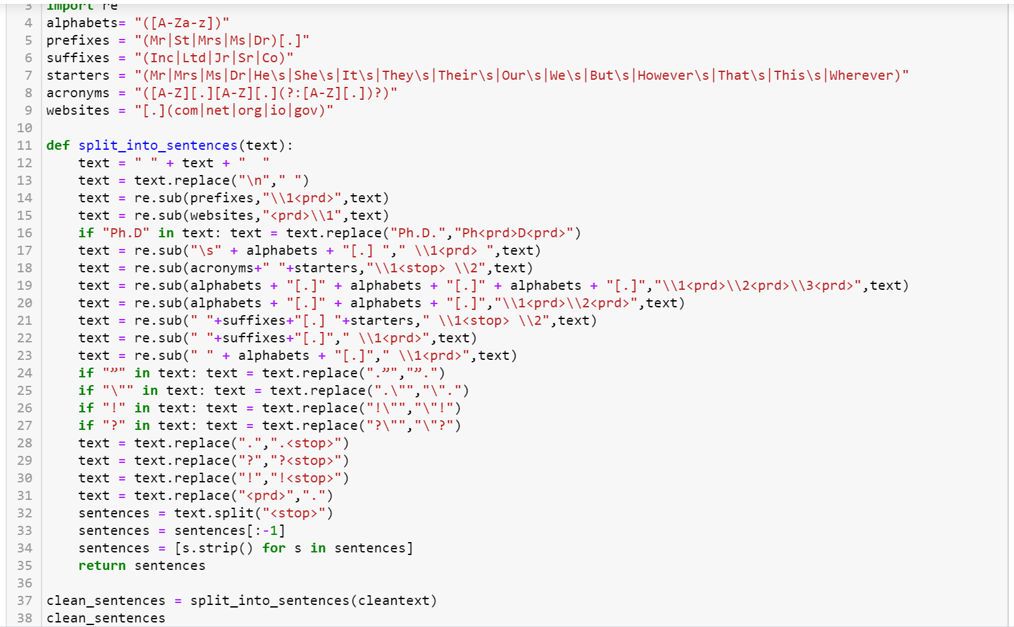
Regex Clean & export for Markup

Slide 10
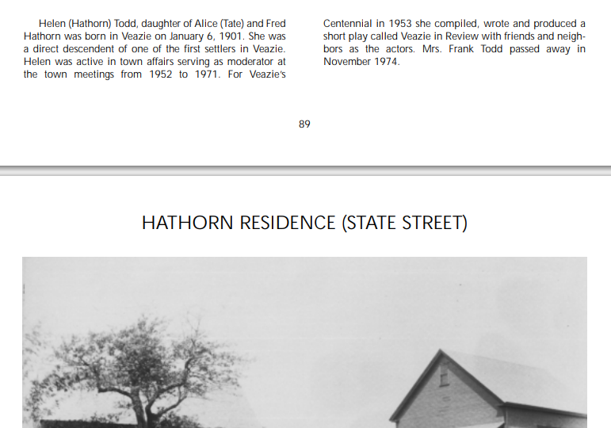
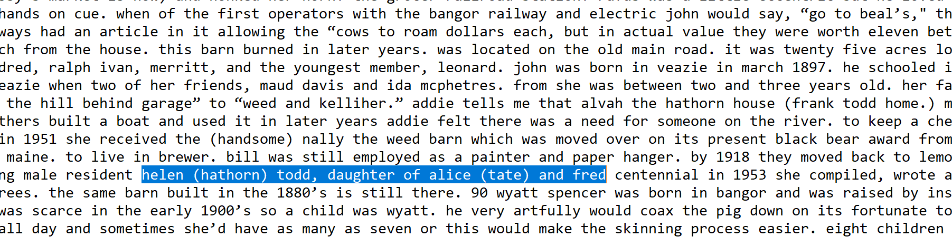
Post cleaning Human contextual review
Columns were treated as a space
…daughter of Alice (tate) and Fred –
…Centennial in 1953 she compiled, wrote…

Slide 11
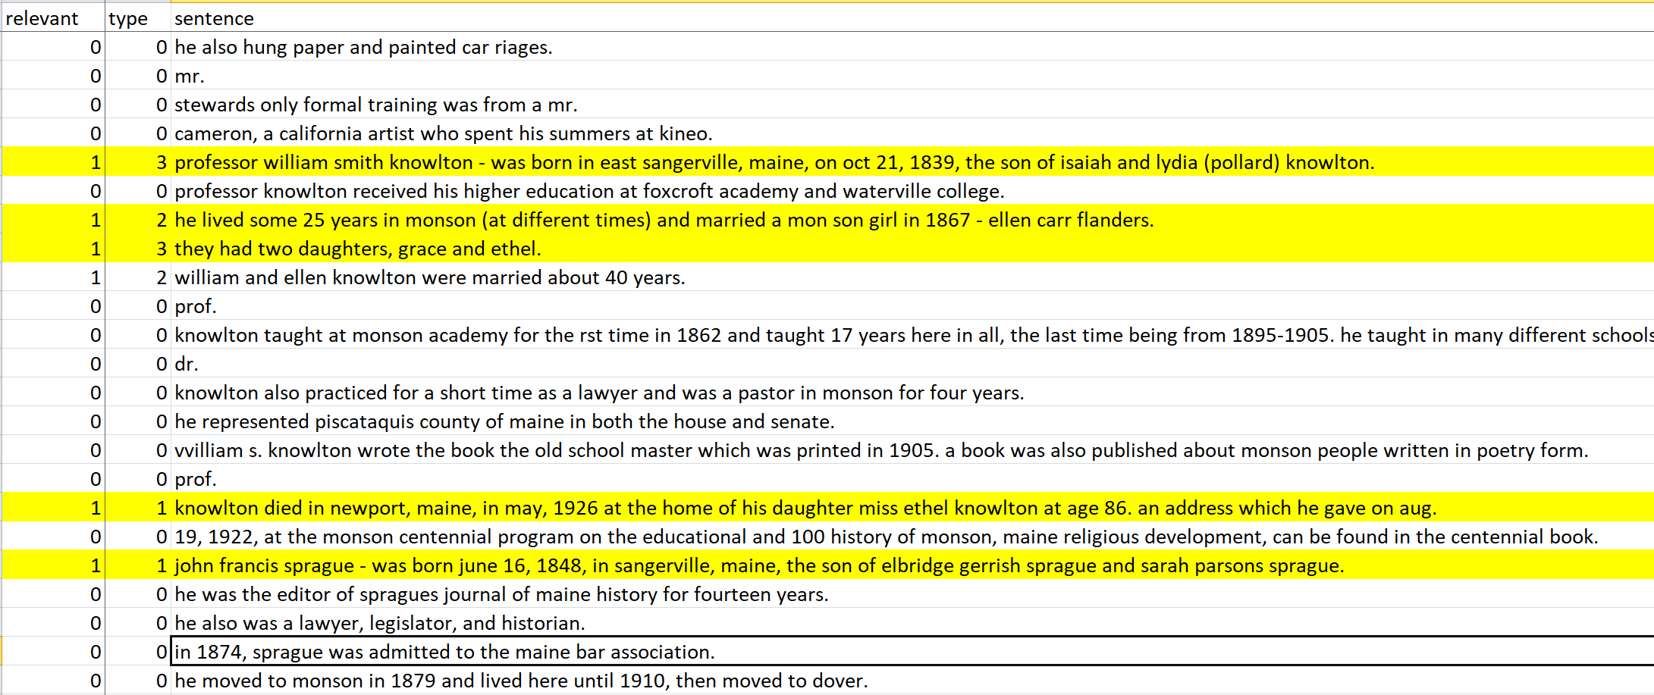
Markup Observations:
Large degree of separation
They refers to earlier sentence
Several prepositional phrases that give clues about relationships

Slide 12
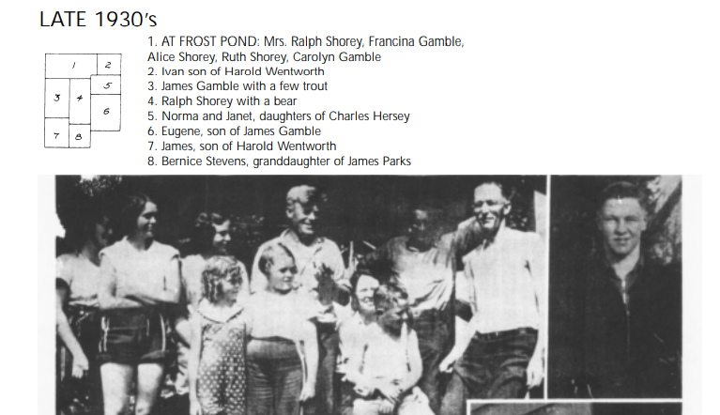
Semi-Structured - actually bad
Same Names in a picture no keyword

Slide 13
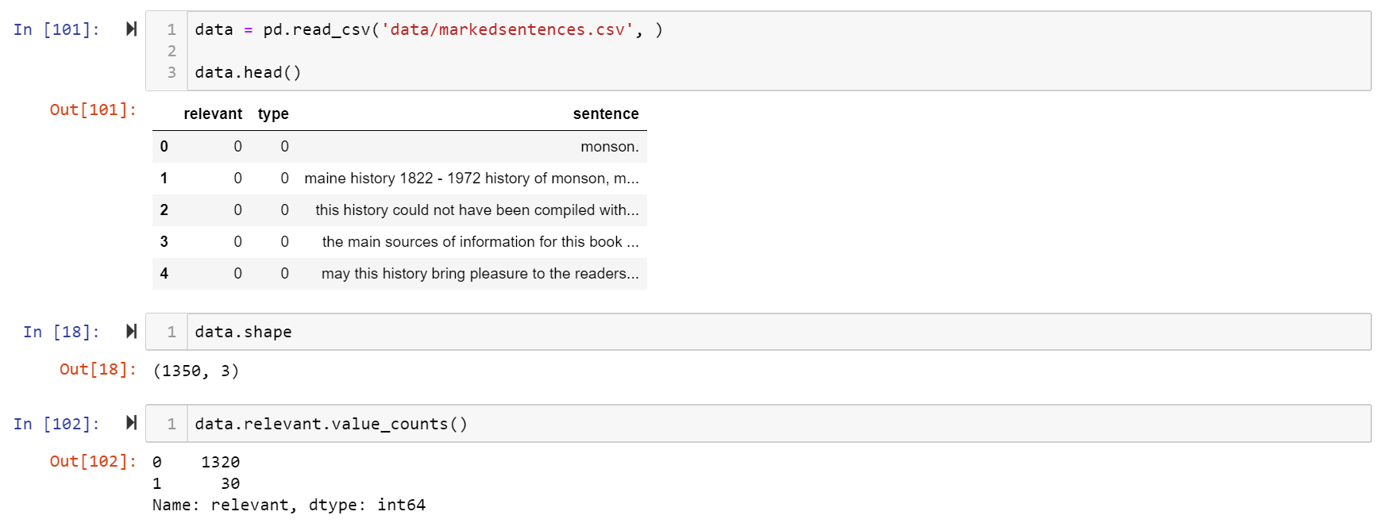
Training the Machine
1320 sentences from 160 pages
30 Marked as relevent

Slide 14
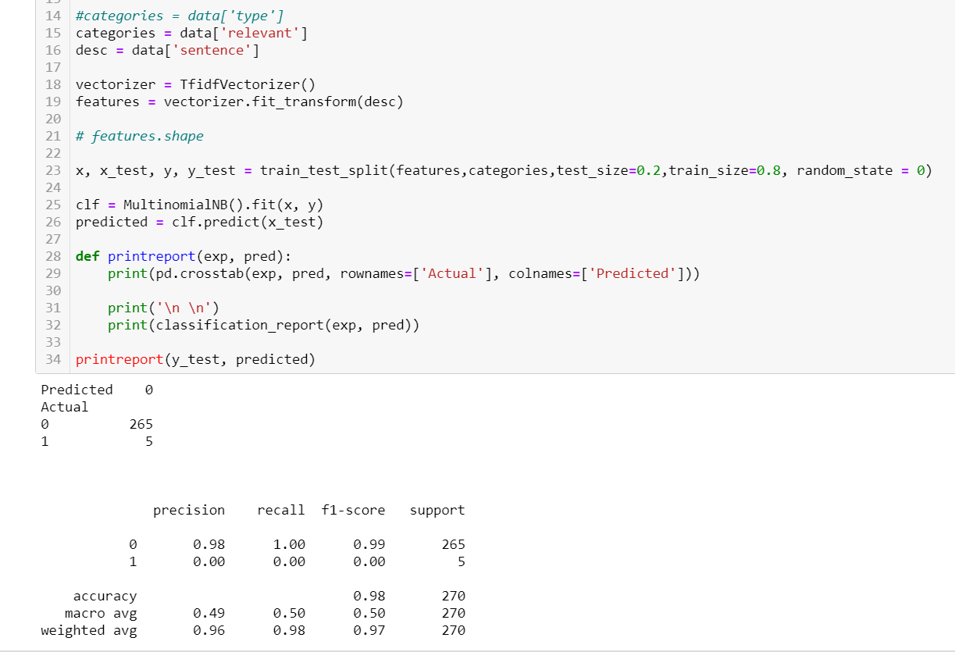
Sample Size too Small!
Lesson – Bigger Corpus is Needed

Slide 15
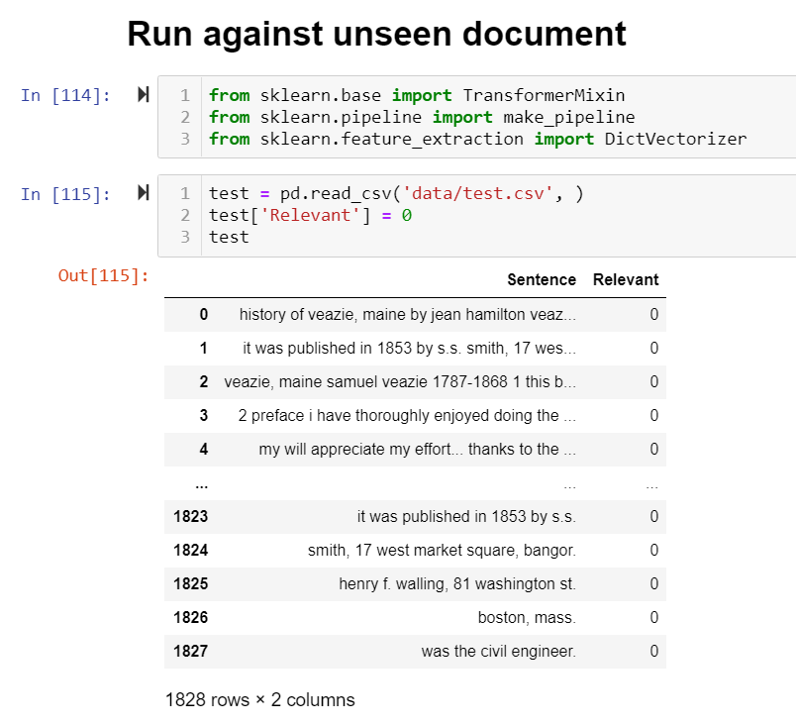
The History of Veazie Maine
Same Extraction Cleaning
Similar size document
Same type of relations
Similar writing style
Same State
Same timeframes

Slide 16
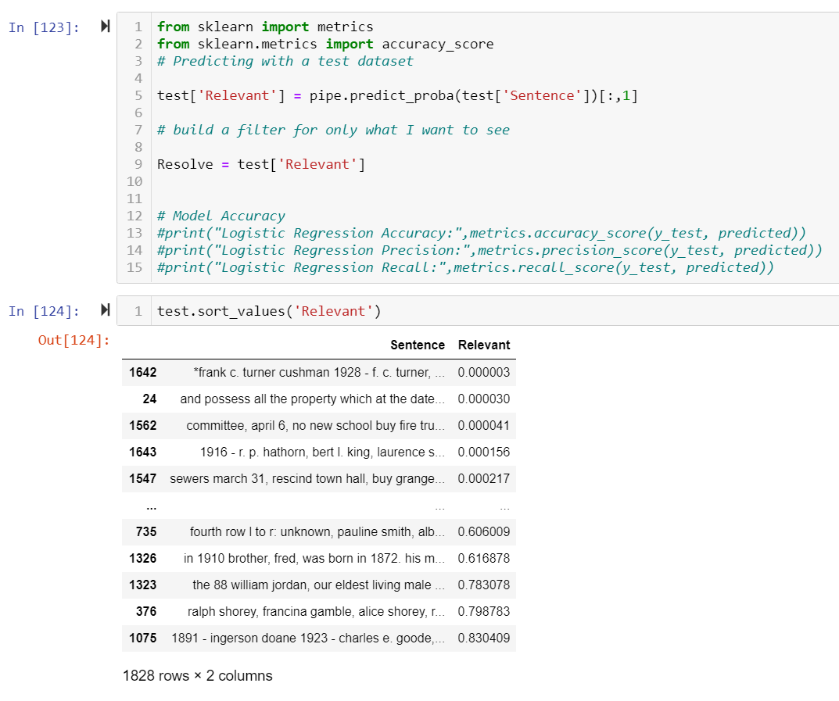
Logistic Regression - Relevence

Slide 17
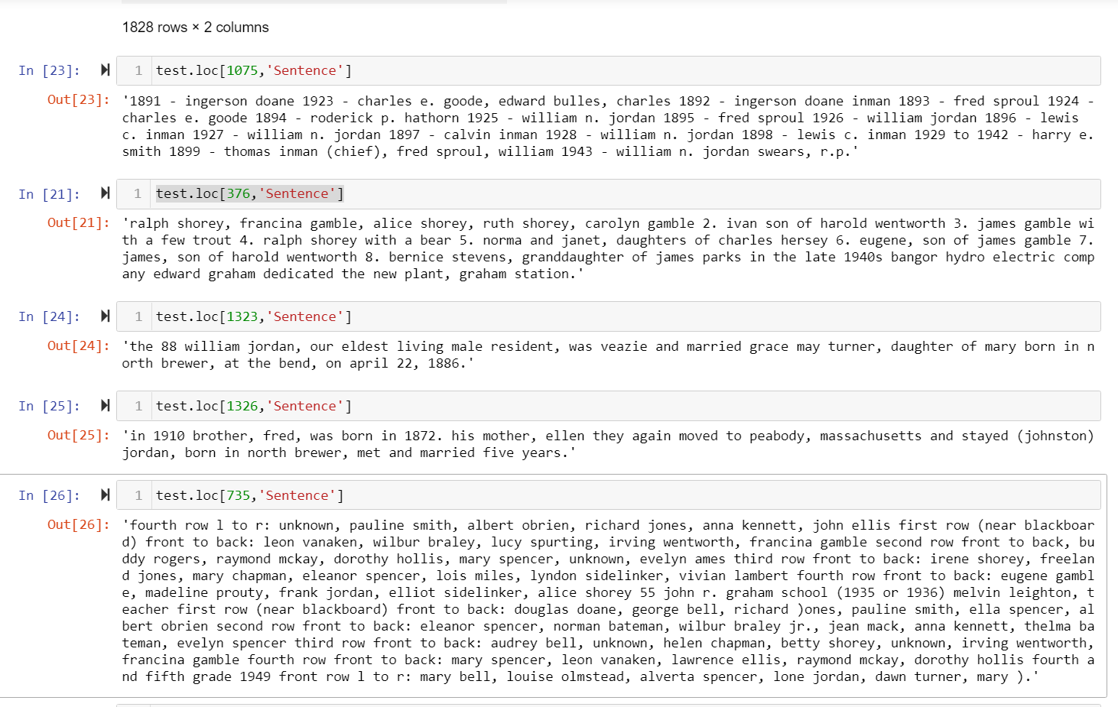
Top 5 Relevent Sentences
List of Names
Parent – Children - Grandchildren
Parent – Children
Sibling
Parent – Children
List of Names

Slide 18
Next Steps OODA -- FEEDBACK
First Pass is Machine Tagged Relevance
I discovered my loop actually allows me to add text easily append sentences to my corpus for marking and building
Second Pass is Keyword Context and spacey NEO
Develop a second level processing function to extract relationship keywords and nearest Proper Nouns relationships

Slide 19

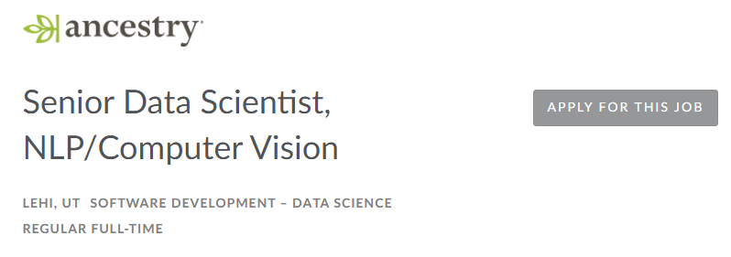

Slide 20
Questions
Thank You!

